Slide 1
Addis Ababa Science and Technology University
Department of Software Engineering
Fundamentals of Database
Ch-4 Slide
Lecturer : Yaynshet.M

Slide 2
As the database grows,
the ERD representation becomes more complex and crowd.
which creates difficult situation to understand the requirement and their structure as a whole.
If the ERD is represented at very high level
creates a difficulty in understanding the system.
Representing at high level and till the minute level is necessary to understand the system well
Such concepts are well defined by generalization and specialization.

Slide 3
Sometimes we would have divided the entities in to two or more entities to be more accurate in design
But When compared to the whole database or user it can be combined to one entity (which is called aggregation)
After designing ER diagram is complete, we need to put it into logical structure

Slide 4
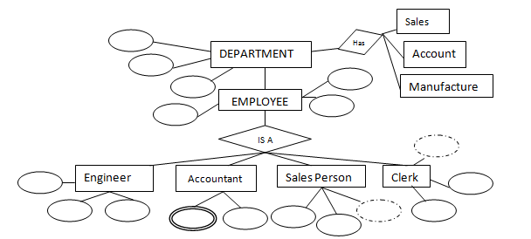
Generalization
In the Employee example

Slide 5
What if we group all the sub departments into one department and different employees into one employee?
sub departments and different employee types have same features in their own domain.
So if we merge the child entities into their parent, it makes the diagram simpler, hence easy to understand.
This method of merging the branches into one is called generalization.

Slide 6
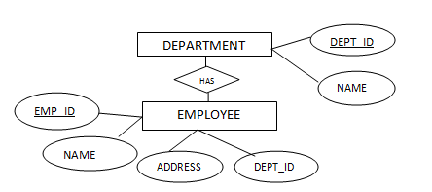
So above ER diagram will be changed to as below:

Slide 7
Specialization
It is opposite approach of generalization.
Each entity is further divided into sub levels to understand it deeper.
In the above example, Department entity is further divided into sub departments to understand how they are scattered.
This method of representation helps the developer to code correctly and quickly.
It is a top down approach of breaking higher level entity to low level entity.
Once the entities are understood at higher level, it makes easy to understand the requirement at low level.

Slide 8
One more example of specialization would be Person.
We can further divide person as STUDENT, TEACHER, ENGINEER, SOLDIER etc.
(Merging STUDENT, TEACHER, ENGINEER etc into PERSON is an example of generalization).

Slide 9
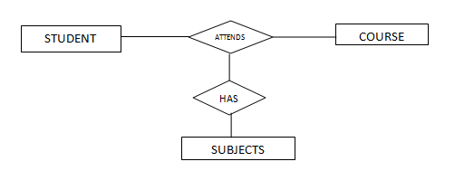
Aggregation
Look at below ER diagram of STUDENT, COURSE and SUBJECTS.
What does it infer?
Student attends the Course, and
he has some subjects to study, At the same time,
Course offers some subjects.
Here a relation is defined on a relation.
The E-R model cannot express relationships among relationships..
It supports mapping between entities, not between relations.
So what can we do in this case?

Slide 10
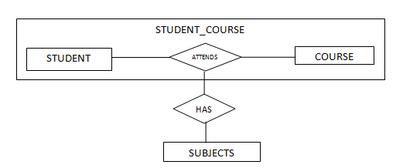
Relationship sets attends and Has could be combined into a single set. However, they shouldn't be, as this would make the logical structure of this scheme not clear and difficult to understand.
Here we have merged/treated STUDENT and COURSE into one entity STUDENT_COURSE.
This new entity forms the mapping with SUBJECTS.
in turn has two entities STUDENT and COURSE with ‘Attends’ relationship.

Slide 11
If we look at STUDENT and COURSE from SUBJECT’s point of view, it does not differentiate both of them.
It offers it’s subject to both of them.
So what can we do here is, merge STUDENT and COURSE as one entity.
This process of merging is called aggregation.
It is completely different from generalization.
In generalization, we merge entities of same domain into one entity.
In this case we merge related entities into one entity.

Slide 12
Logical database design
Logical design is the process of constructing a model of the information used in an enterprise based on a specific data model (e.g. relational, hierarchical or network or object), but independent of a
particular DBMS i.e., Oracle, SQL, MySQL, Postgres…
Features /limitations of specific DBMS
physical considerations.
Normalization process
Collection of Rules to be maintained
Discover new entities in the process
Revise attributes based on the rules and the discovered Entities
Physical database design
Logical design adopted to particular DBMS
The DB can be changed slightly to fit into features/limitations of a DBMS
The first step before applying the rules in relational data model is converting the conceptual design to a form suitable for relational logical model, which is in a form of tables.
Converting ER Diagram to Relational Tables
using ER diagrams one can easily create relational data model, which nothing but the logical view of the database.
Consider the ER diagram below and will see how it is converted into tables, columns and mappings.

Slide 13
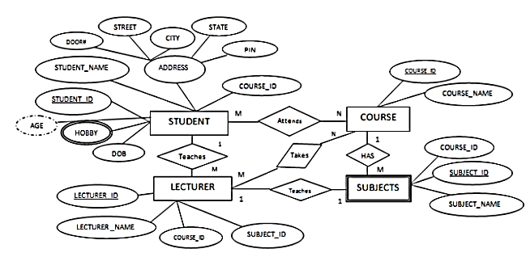
1. The basic rule for converting the ER diagrams into tables
Convert all the Entities in the diagram to tables
All the entities represented in the rectangular box in the ER diagram become independent tables in the database.
In the diagram, STUDENT, COURSE, LECTURER and SUBJECTS forms individual tables

Slide 14
All single valued attributes of an entity is converted to a column of the table
All the attributes, whose value at any instance of time is unique, are considered as columns of that table.
In the STUDENT Entity, STUDENT_ID, STUDENT_NAME form the columns of STUDENT table.
Similarly, LECTURER_ID, LECTURER_NAME form the columns of LECTURER table. And so on

Slide 15
Declare the foreign key column, if applicable.
In the diagram, attribute COURSE_ID in the STUDENT entity is from COURSE entity.
Hence add COURSE_ID in the STUDENT table and assign it foreign key constraint.
COURSE_ID and SUBJECT_ID in LECTURER table forms the foreign key column.
Hence by declaring the foreign key constraints, mapping between the tables are established.

Slide 16
Any multi-valued attributes are converted into new table.
A hobby in the Student table is a multivalued attribute.
Any student can have any number of hobbies.
So we cannot represent multiple values in a single column of STUDENT table.
We need to store it separately, so that we can store any number of hobbies, adding/ removing / deleting hobbies should not create any redundancy or anomalies in the system.
Hence we create a separate table STUD_HOBBY with STUDENT_ID and HOBBY as its columns.
We create a composite key using both the columns

Slide 17
Any composite attributes are merged into same table as different columns.
In the diagram above, Student Address is a composite attribute.
It has Door#, Street, City, State and Pin.
These attributes are merged into STUDENT table as individual columns.

Slide 18
One can ignore derived attribute, since it can be calculated at any time.
In the STUDENT table, Age can be derived at any point of time by calculating the difference between DateOfBirth and current date.
Hence we need not create a column for this attribute.
It reduces the duplicity in the database.

Slide 19
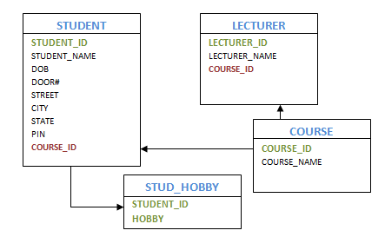
Table structure at this would be as below

Slide 20
2. Let us see some of the special cases
Converting Weak Entity
Weak entity is also represented as table.
All the attributes of the weak entity forms the column of the table.
But the key attribute represented in the diagram cannot form the primary key of this table.
We have to add a foreign key column, which would be the primary key column of its strong entity.
This foreign key column along with its key attribute column forms the primary key of the table

Slide 21
In our example above, SUBJECTS is the weak entity.
Hence, we create a table for it.
Its attributes SUBJECT_ID and SUBJECT_NAME forms the column of this table.
Although SUBJECT_ID is represented as key attribute in the diagram, it cannot be considered as primary key.
In order to add primary key to the column, we have to find the foreign key first.
COURSE is the strong entity related to SUBJECT.
Hence the primary key COURSE_ID of COURSE is added to SUBJECT table as foreign key.
Now we can create a composite primary key out of COURSE_ID and SUBJECT_ID.

Slide 22
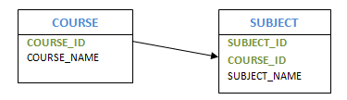
Representing 1:1 relationship
Imagine SUBJECT is not a weak entity, and we have LECTURER teaches SUBJECT relation.
It is a 1:1 relation. i.e.; one lecturer teaches only one subject.
We can represent this case in two ways
Create table for both LECTURER and SUBJECT.
Add the primary key of LECTURER in SUBJECT table as foreign key.
It implies the lecturer name for that particular subject.
2. Create table for both LECTURER and SUBJECT.
Add the primary key of SUBJECT in LECTURER table as foreign key.
It implies the subject taught by the lecturer.

Slide 23
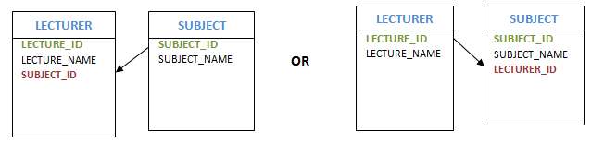
In both the case, meaning is same.
Foreign key column can be added in either of the table, depending on the developer’s choice.
Representing 1:N relationship
Consider SUBJECT and LECTURER relation, where each Lecturer teaches multiple subjects.
This is a 1: N relation.
In this case, primary key of LECTURER table is added to the SUBJECT table.
i.e.; the primary key at 1 cardinality entity is added as foreign key to N cardinality entity

Slide 24
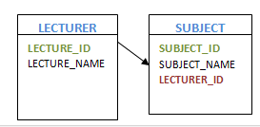
Representing M:N relationship
Consider the example, multiple students enrolled for multiple courses,
which is M:N relation.
In this case,
we create STUDENT and COURSE tables for the entities.
Create one more table for the relation between them and name it as STUD_COURSE.
Add the primary keys of COURSE and STUDENT into it along with some additional attributes (if applicable) ,
which forms the composite primary key of the new table.

Slide 25
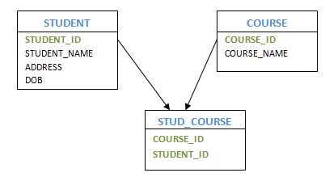
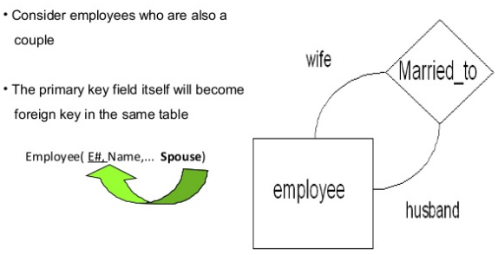
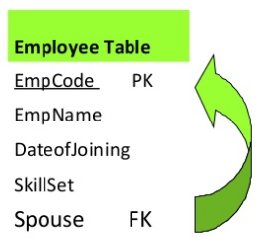
1
Self referencing 1:1
.

Slide 26
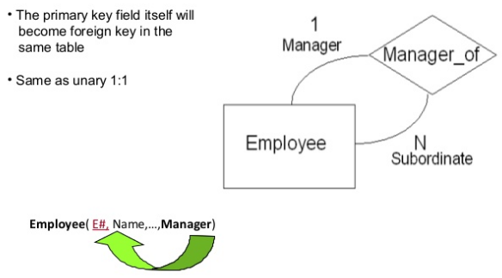
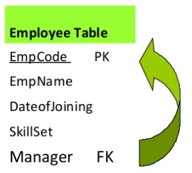
Self referencing 1:N

Slide 27
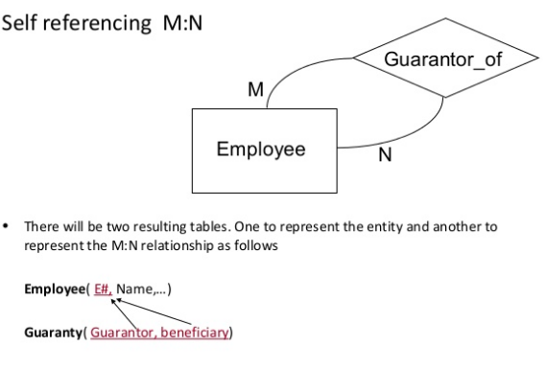
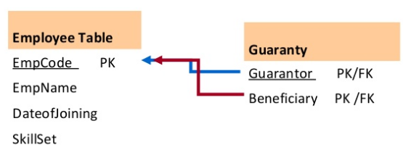

Slide 28
After converting the ER diagram in to table forms, the next phase is implementing the process of normalization, which is a collection of rules each table should satisfy.
Codd created a series of rules called normal forms that help define that organization
Database normalization
is a series of steps followed to obtain a database design that allows for consistent storage and efficient access of data in a relational database.
These steps reduce data redundancy and the risk of data becoming inconsistent.

Slide 29
A relational database is merely a collection of data, organized in a particular manner
One of the best ways to determine what information should be stored in a database is
to clarify what questions will be asked of it and
what data would be included in the answers
NORMALIZATION
identifying the logical associations between data items and
designing a database that will represent such associations but without suffering the update anomalies which are;
1. Insertion Anomalies
2. Deletion Anomalies
3. Modification Anomalies
The purpose of normalization is to reduce the chances for anomalies to occur in a database.

Slide 30
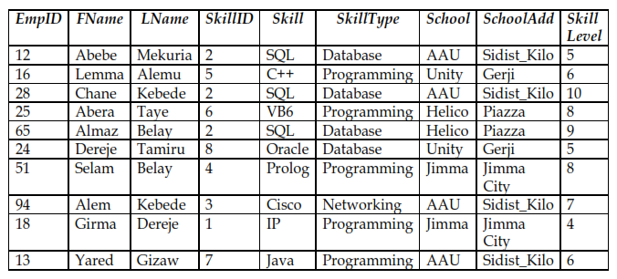
Example of problems related with Anomalies

Slide 31
Deletion Anomalies:
If employee with ID 16 is deleted then
every information about skill C++ and
the type of skill is deleted from the database.
Then we will not have any information about C++ and its skill type.
Insertion Anomalies:
What if we have a new employee with a skill Pascal?
We cannot decide whether Pascal is allowed as a value for skill and
we have no clue about the type of skill that Pascal should be categorized as.
Modification Anomalies:
if the address for Helico is changed from Piazza to Mexico?
We need to look for every occurrence of Helico School_Add from Piazza to Mexico,
which is prone to error.

Slide 32
Functional Dependency (FD)
Before moving to the definition and application of normalization,
it is important to have an understanding of "functional dependency."
Data Dependency
The logical associations between data items that point the database designer in the direction of a good database design are referred to as
determinant or dependent relationships
Two data items A and B are said to be in a determinant or dependent relationship if certain values of data item B always appears with certain values of data item A

Slide 33
if the existence of something, call it A, implies that B must exist and have a certain value, then
we say that "B is functionally dependent on A."
We also often express this idea by saying that
"A determines B," or
"B is a function of A," or
"A functionally governs B.“
Often, the ideas of functionality and functional dependency are expressed briefly by the statement,
"If A, then B."

Slide 34
The notation is: A→B which is read as;
B is functionally dependent on A
In general, a functional dependency is a relationship among attributes.
In relational databases, we can have a determinant that governs one other attribute or several other attributes.
NB: FDs are derived from the real-world constraints on the attributes.

Slide 35
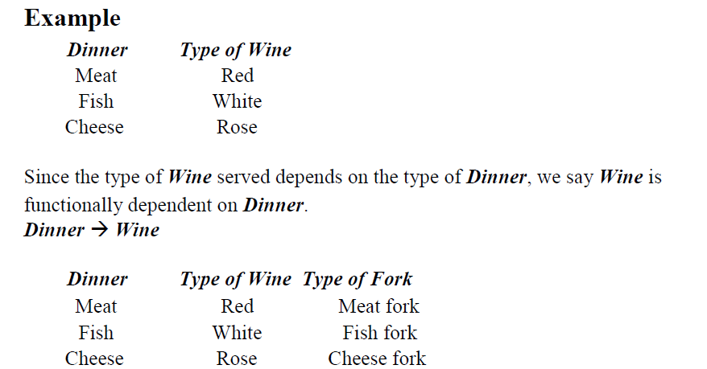

Slide 36
Since both Wine type and Fork type are determined by the Dinner type, we say
Wine is functionally dependent on Dinner and
Fork is functionally dependent on Dinner.
Dinner → Wine
Dinner → Fork
Partial Dependency
If an attribute which is not a member of the primary key is dependent on some part of the primary key (if we have composite primary key) then
that attribute is partially functionally dependent on the primary key.
Let {A,B} is the Primary Key and C is no key attribute.
Then if {A, B} →C and B→C or A→C
Then C is partially functionally dependent on {A, B}

Slide 37
Full Dependency
If an attribute which is not a member of the primary key is not dependent on some part of the primary key but the whole key (if we have composite primary key) then
that attribute is fully functionally dependent on the primary key.
Let {A, B} is the Primary Key and C is no key attribute
Then if {A, B} →C and B→C and A→C
Then C Fully functionally dependent on {A, B}

Slide 38
Transitive Dependency
"If A implies B, and
if also B implies C, then
A implies C."
Example:
If Mr X is a Human, and if every Human is an Animal, then Mr X must be an Animal.
Generalized way of describing transitive dependency is that:
If A functionally governs B, AND
If B functionally governs C
THEN A functionally governs C
Provided that neither C nor B determines A i.e. (B /→ A and C /→ A)

Slide 39
In the normal notation:
{(A→ B) AND (B→ C)} ==> A→C provided that
B /→ A and
C /→ A
Steps of Normalization
We have various levels or steps in normalization called Normal Forms.
as we move from one lower level Normal Form to the higher
The level of complexity, strength of the rule and decomposition increases.
A table in a relational database is said to be in a certain normal form if it satisfies certain constraints.

Slide 40
Normalization towards a logical design consists of the following steps:
Un-Normalized Form:
Identify all data elements
First Normal Form:
Find the key with which you can find all data
Second Normal Form:
Remove part-key dependencies.
Make all data dependent on the whole key.
Third Normal Form
Remove non-key dependencies.
Make all data dependent on nothing but the key.
For most practical purposes, databases are considered normalized if they adhere to third normal form.

Slide 41
First Normal Form (1NF)
Requires that all column values in a table are atomic
We have two ways of achieving this:
1. Putting each repeating group into a separate table and connecting them with a primary key-foreign key relationship
2. Moving these repeating groups to a new row by repeating the common attributes.
2.1 If so then find the key with which you can find all data

Slide 42
Definition: a table (relation) is in 1NF
If
There are no duplicated rows in the table. Unique identifier
Each cell is single-valued (i.e., there are no repeating groups).
Entries in a column (attribute, field) are of the same kind.

Slide 43
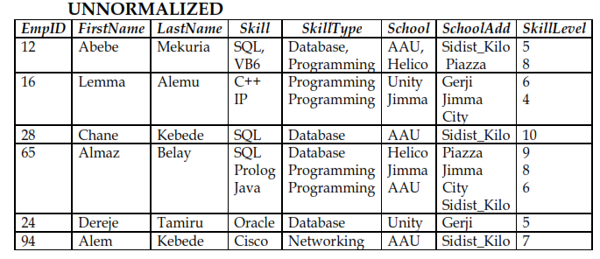

Slide 44
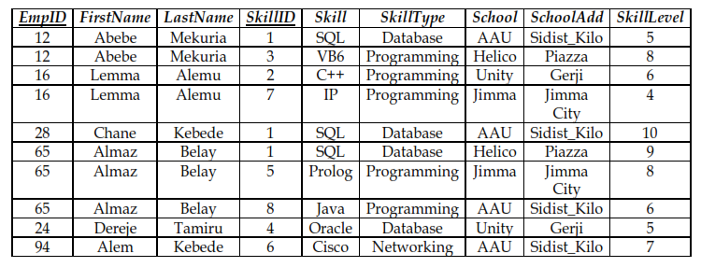
FIRST NORMAL FORM (1NF)
Remove all repeating groups.
Distribute the multi-valued attributes into different rows and
identify a unique identifier

Slide 45
Second Normal form 2NF
No partial dependency of a non-key attribute on part of the primary key.
This will result in a set of relations with a level of Second Normal Form.
Any table that is in 1NF and has a single-attribute (i.e., a non-composite) primary key is automatically in 2NF.
Definition: a table (relation) is in 2NF
If
It is in 1NF and
If all non-key attributes are dependent on the entire primary key. i.e. no partial dependency.

Slide 46
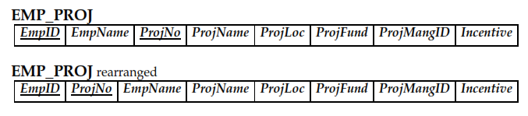
Example for 2NF:
Business rule: Whenever an employee participates in a project,
he/she will be entitled for an incentive.
since we don’t have any repeating groups or attributes with multi-valued property.
This schema is in its 1NF

Slide 47
To convert it to a 2NF
we need to remove all partial dependencies of non-key attributes on part of the primary key.
{EmpID, ProjNo}→EmpName, ProjName, ProjLoc, ProjFund, ProjMangID, Incentive
But in addition to this we have the following dependencies
FD1: {EmpID} → EmpName
FD2: {ProjNo} → ProjName, ProjLoc, ProjFund, ProjMangID
FD3: {EmpID, ProjNo} → Incentive
As we can see,
some non-key attributes are partially dependent on some part of the primary key.
This can be witnessed by analyzing FD1 and FD2.

Slide 48
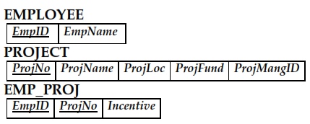
Thus, each Functional Dependencies, with their dependent attributes should be moved to a new relation where the Determinant will be the Primary Key for each.

Slide 49
Third Normal Form (3NF)
Eliminate Columns Dependent on another non-Primary Key
Definition: a Table (Relation) is in 3NF
If
It is in 2NF and
There are no transitive dependencies between a primary key and non-primary key attributes.
Example for (3NF)
Assumption: Students of same batch (same year) live in one building or dormitory

Slide 50
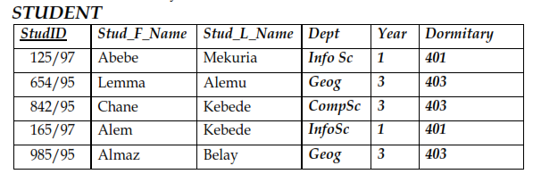
This schema is in its 2NF.
Let’s take StudID, Year and Dormitary and see the dependencies.
StudID→ Year AND
Year→ Dormitary And
Year cannot determine StudID and
Dormitary cannot determine StudID Then transitively
StudID→ Dormitary
To convert it to a 3NF
we need to remove all transitive dependencies i.e,. StudID→ Dormitary
The non-primary key attributes, dependent on each other i.e., Year→ Dormitary
will be moved to another table and linked with the main table using Candidate Key- Foreign Key relationship.

Slide 51
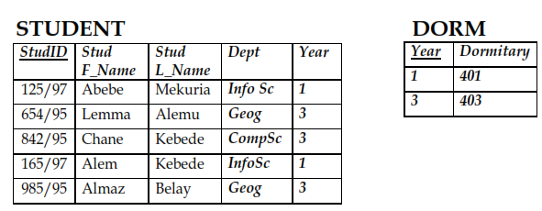
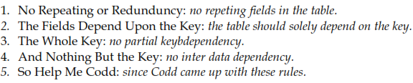
Generally, eventhough there are other four additional levels of Normalization, a table is said to be normalized if it reaches 3NF.
A database with all tables in the 3NF is said to be Normalized Database.
Mnemonic for remembering the rationale for normalization up to 3NF could be the following:

Slide 52
The end!!!

